Slide 1

Trustworthy E-voting System
https://github.com/sangatisurekha/Final-review
Batch No: B-12 Project Guide:
S.Surekha (164G1A05A8) Dr.G.K.V.Narasimha Reddy, Ph.D
B.Sheshi Rekha (164G1A0595) Professor & HOD `
P.Rohith (164G1A0582)
K.Simran (164G1A0596)
Srinivasa Ramanujan Institute of Technology
Department of Computer Science & Engineering

Slide 2
Contents
Introduction
Abstract
Module Description
Output
Conclusion
References

Slide 3
Introduction
The online voting system is the system that aims in reducing the complexity and cost of the election process.
Here the voter can vote in spite of his absence in the particular locality.
The administrator’s effort is much reduced by checking the election status of all the localities individually forms a place and it is easy for him to announce the election result.
This system mainly used to avoid illegal polling.

Slide 4
Existing System
In the current system, voting is generally done either by writing your opinion on the paper or by electronic voting machines.
In this voters cast their vote from the polling stations held at particular locations by standing in long queues.
In this system their is chance of occuring illegal activites.
It takes a lot of time to declare the results.

Slide 5
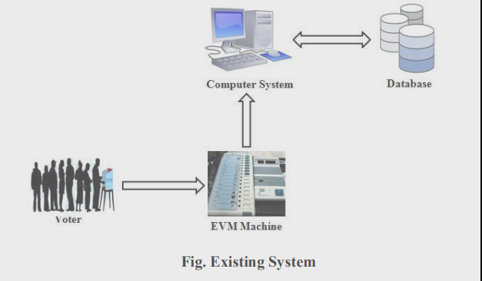

Slide 6
Proposed System
The proposed system is a web based application.
As it a web application voters can cast their votes from any location.
No user can cast multiple votes. And the results will declare in very less time.
By this system voters can cast votes easily and fastly. As they can access the system without going to polling booths and standing in long queues.
And it is very helpful to people who are unable to go to polling booths.

Slide 7
Abstract
Problem Statement:
Building a trustworthy voting system by providing integrity, accountability and irreversible. And it could increase voter turnout because of convenience, and it helps to reduce fraud voting.

Slide 8
Module Description
The Proposed System consists of two modules:
Administrator Module
Voter Module

Slide 9
Contd…
Administrator Module:
Administrator interface consists of user name
and unique password to login onto the system.
The following tasks performed by the administrator:
1. Select Candidate-
Here the admin can select the list of candidates in
the election.
The candidates will be added to the list only after
completing the procedures.

Slide 10
Contd…
2. Add election-
Here the election to be conducted is selected.
To add an election should be give required fields like
name,description, start date, end date along with timings.
3.Select candidate list
4.Voting Structure
5.Counting and Characterizing the results

Slide 11
Contd…
Voter Module:
First voter should register for the election. On
the day of election voter login through voterid and
password.
1.Authentication & Voting
2.Candidate List
This facilitates the voter to view the candidate
names and the election name.

Slide 12
Contd…
3.Vote-
This provides the voter with a list of candidate with
in his/her election along with selection option to select the preferred candidate from the list.
5.View Results-
This provides user friendly representation of the votes
obtained by each candidate.
It includes the votes obtained by each candidate.
6.Logout

Slide 13
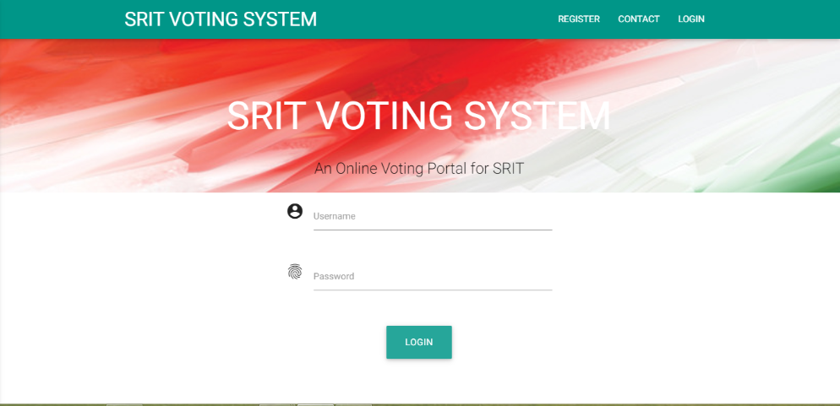
Output Screens
Fig: 1 admin and voter login form

Slide 14
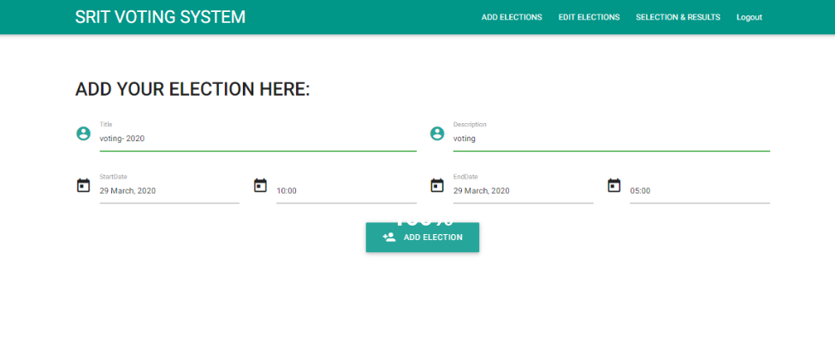
Fig: 2 Admin add the election

Slide 15
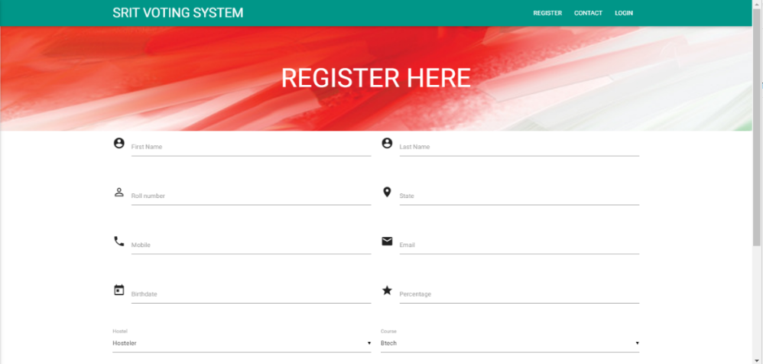
Fig:3 voters register for the election

Slide 16
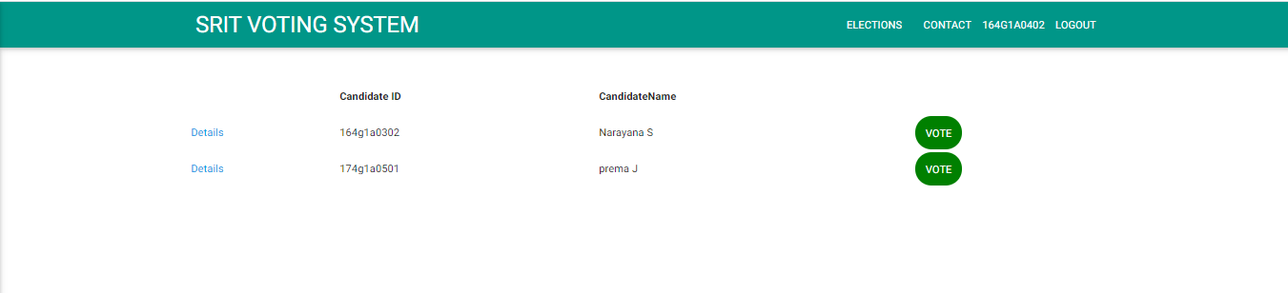
Fig: 4 voter vote for candidate

Slide 17
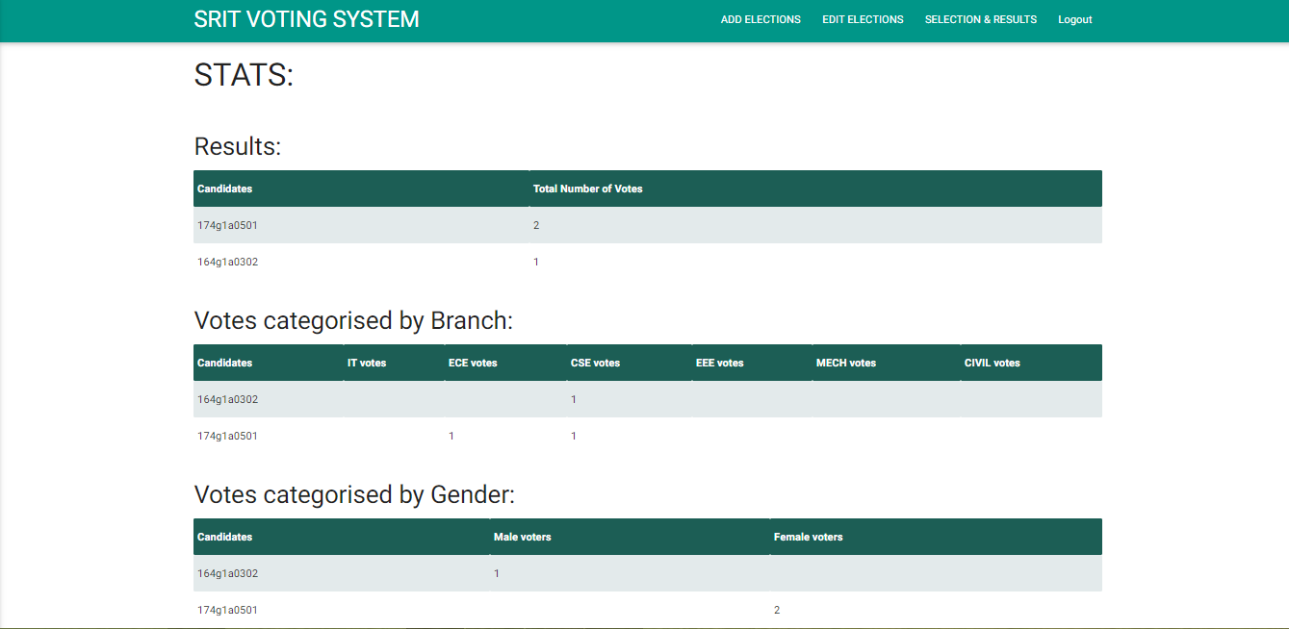
Fig: 5 characterising the results

Slide 18
Conclusion
By doing this project we were able to bring a new system for online national voting for our college. With the advent of technology and Internet in our day to day life, we were able to offer advanced voting system to voters both in the college and outside through our Online voting system.

Slide 19
References
Kanika Garg, Pavi Saraswat, Sachin Bisht, Sahil Kr. Aggarwal, Sai Krishna Kothuri, Sahil Gupta, "A Comparative Analysis on E-Voting System Using Blockchain", Internet of Things: Smart Innovation and Usages 2019 4th International Conference on, pp. 1-4, 2019..
Ashish Singh, Kakali Chatterjee, “Secure Electronic Voting System Using Blockchain Technology”, 2018 International Conference on Computing, Power and Communication Technologies (GUCON) Galgotias University,2018
Friðrik Þ. Hjálmarsson, Gunnlaugur K. Hreiðarsson, Mohammad Hamdaqa, Gísli Hjálmtýsson, “Blockchain based e-voting system”,2018 International Conference.

Slide 20
Thank you
Queries
?

